Slide 1
Kursus Web Application
With PHP & MySQL
INTAN Bukit Kiara
23 – 26 Julai 2018
Disusun oleh :
Murad bin Isa,
Bahagian Teknologi Maklumat,
Institut Tanah dan Ukur Negara (INSTUN)
muradochan@gmail.com, 0122639071 (whatsapp only)

Slide 2
Kursus Web Application With PHP & MySQL
Nama : Murad bin Isa
Tarikh Lahir : 7 April 1970
Berasal dari : Bidor, Perak
Pendidikan : Ijazah Sains Komputer
Pengalaman Kerja : SPR - 1997, JUPEM Perak - 2002, KEKKWA - 2005, JPM - 2007, INSTUN - 2011
Jawatan : Ketua Program, Seksyen Perkhidmatan Teknikal dan Rangkaian, Bahagian Teknologi Maklumat, INSTUN
Minat : movie, youtube
Email : muradochan@gmail.com, murad@instun.gov.my
Tel : 0122639071 - whatsapp only
Nota : https://padlet.com/murado/

Slide 3
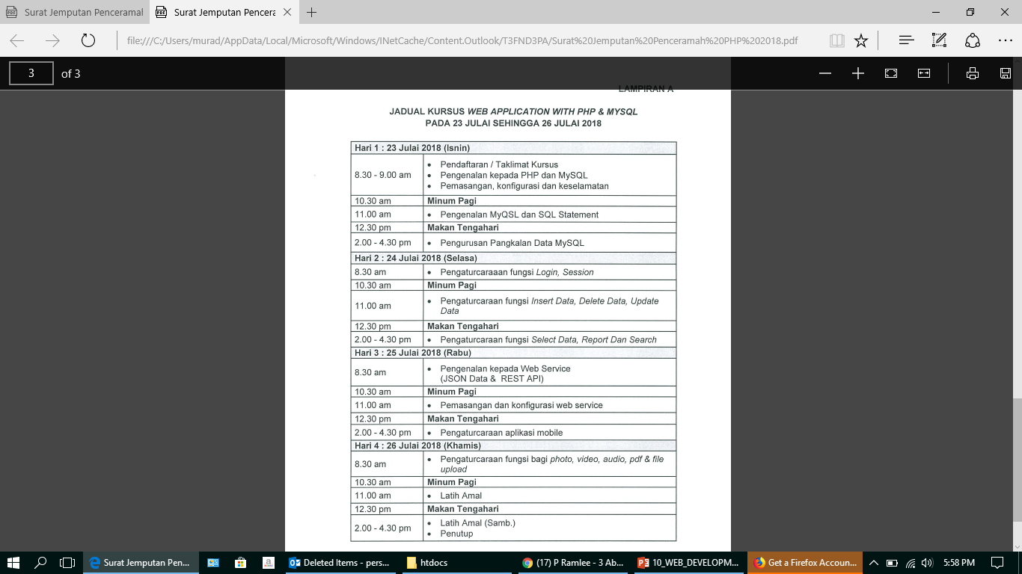
Kursus Web Application With PHP & MySQL
OS, MS window, Linux Ubuntu, XAMPP, MySQL, MariaDB, phpmyadmin, user, PK, FK, index, DB design,
SQL, PHP, Apache,
Security, curl, nmap, nikto, SQL Injection, XSS, login, session, insert, update, delete, select, JSON, REST, web service, PDF, upload, video,

Slide 4
Kursus Web Application With PHP & MySQL
Kenalkan diri anda – nama, berasal dari, jabatan kerja semasa, tempoh pengalaman dalam bidang pembangunan dan aplikasi web PHP,
Nyatakan ‘expectation’ (perkara yang ingin diketahui / dibincangkan) anda dari kursus ini
Jika ada soalan, sila maklumkan dengan segera

Slide 5
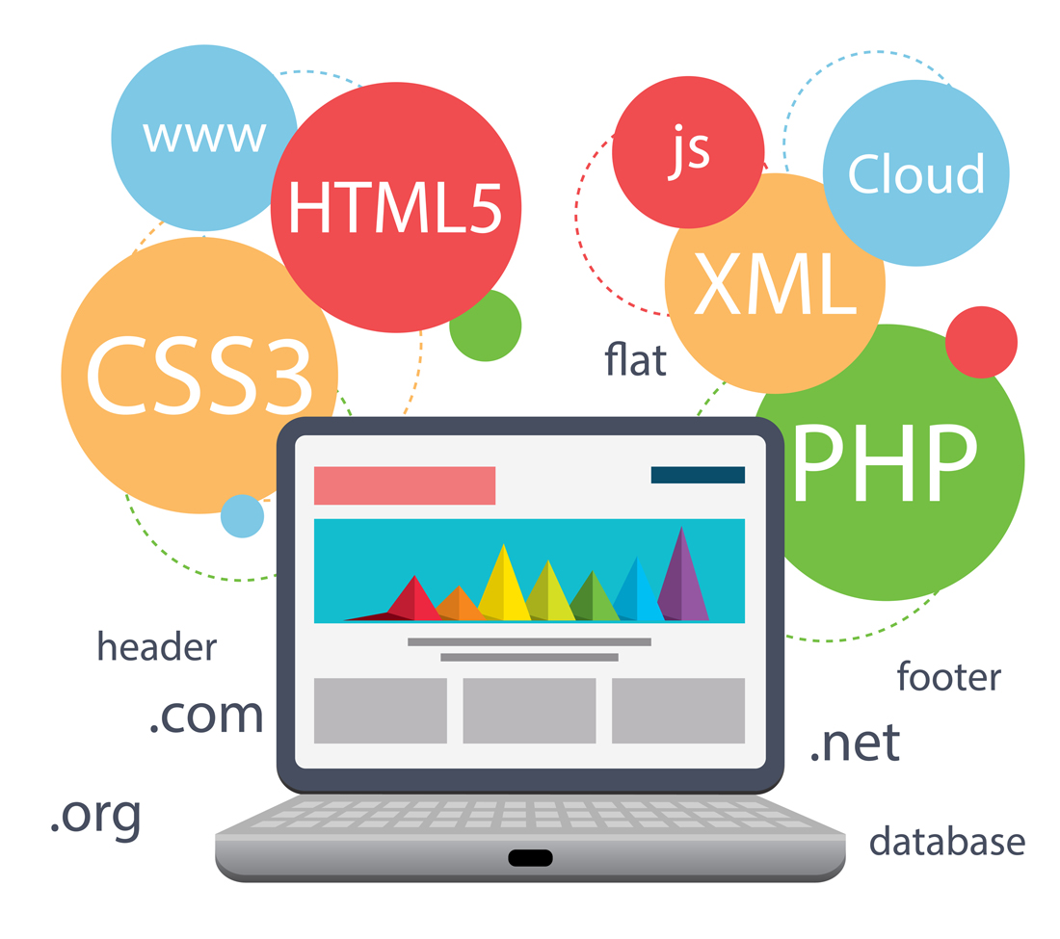
WEB APPLICATION

Slide 6
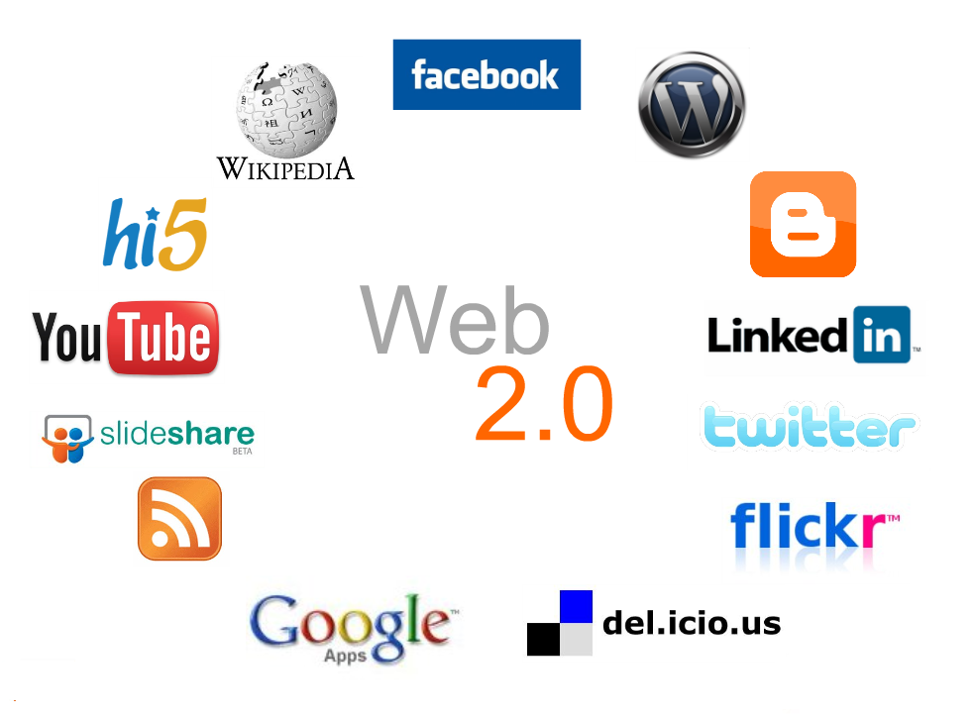

Slide 7
Web Developer
Popular web application development stacks (browser-based) :
Front-end:
HTML, Javascript, CSS
Back-end:
PHP, Java, Javascript, Ruby, .NET, Python

Slide 8
Web Developer
HTML & CSS
We are still learning how to master HTML5 and CSS3
to create fast and beautiful experiences in browsers across our growing list of devices.
That's why many front-end developers (a.k.a. user-experience (UX) designers/engineers) are earning higher wages than server-side developers these days. And for good reason; UX engineering is hard.

Slide 9
Web Developer
JavaScript
JavaScript is hot right now, and it won’t cool off anytime soon (if ever).
While many developers think they "know JavaScript" because they can write a bit of jQuery (which is important, of course), the language is quickly turning into a ubiquitous and robust tool for servers, devices, robots and even web browsers.

Slide 10
Web Developer
Product Management
common complaint :
developers lack product sensibilities
know how to build great products and write great code.

Slide 11
Web Developer
Product Management
understand business objectives
manage a project (in general),
embrace agile work flows
listen effectively to users to tweak a product accordingly.
Writing in a check box versus a radio button, for example, is a business decision. Developers need to learn how to carefully make these kinds of decisions to make the job of full-time product manager less difficult.

Slide 12
Web Developer
Frameworks
web development more pleasant
getting more done in less time (rapid development)
JavaScript, Ruby, PHP, Java, C# and Python all have multiple frameworks designed.

Slide 13
Web Developer
Git
Version control of code - essential.
tool for collaboration, record-keeping and incorporation with deployment processes.
version control system (Subversion, Mercurial, Git, GitHub)

Slide 14
Web Developer
Browser Development tools (Chrome, Firebug)
Firefox - comprehensive debugger - Firebug
understand what the front code was doing.
Chrome’s developer tools - most widely used.

Slide 15
Web Developer
JSON APIs - JavaScript Object Notation (JSON)
dominant language of automated communication between services on the web today.
Developers should know both how to work with APIs and how to build their own.
web development is becoming increasingly modularized as service-oriented architectures
JavaScript frameworks become more prevalent, designing for mobile

Slide 16
Web Developer
Caching
Speed - important factors for a great user experience on the web. HTTP caching
unnecessary number of calls to a database and/or file system is a great way to slow things down and annoy users.
how to get as much data in memory
Most modern frameworks have built-in ways to use memory and file-system caching

Slide 17
Web Developer
Interface and User Experience
test on major browsers, cell phones, screen readers and search engines
Test server. Staging server. deploy updates without affecting users.
version control system (git, Subversion, etc.)
Don't display unfriendly errors directly to the user.

Slide 18
Web Developer
Interface and User Experience
Redirect after a POST if that POST was successful, to prevent a refresh from submitting again.
Don't make user ‘think’
https://99designs.com/blog/tips/7-unbreakable-laws-of-user-interface-design/
https://www.usability.gov/what-and-why/user-interface-design.html

Slide 19
Web Developer
Security
Open Web Application Security Project (OWASP)
Avoid SQL Injection. Never trust user input
Hash passwords using salt
Enable HTTPS - Let's Encrypt (or others)
Prevent session hijacking.
Avoid cross site scripting (XSS).
Avoid cross site request forgeries (CSRF).
Avoid Clickjacking.
System - up to date, latest patches.
Secure database connection

Slide 20
Web Developer
Performance
Optimize images - don't use a 20 KB image for a repeating background.
Learn how to gzip/deflate content (deflate is better).
Make sure there’s a favicon.ico file in the root of the site, i.e. /favicon.ico. Browsers will automatically request it, even if the icon isn’t mentioned in the HTML at all. If you don’t have a /favicon.ico, this will result in a lot of 404s, draining your server’s bandwidth.

Slide 21
Web Developer
SEO (Search Engine Optimization)
Use "search engine friendly" URL
example.com/pages/45-article-title
example.com/index.php?page=45
Do not use links - “click here”.

Slide 22
Web Developer
Technology
Understand HTTP, GET, POST, sessions, cookies, stateless
JavaScript frameworks (jQuery, MooTools, Prototype, Dojo or YUI 3)
Don't reinvent the wheel.

Slide 23
Web Developer
Bug fixing
Understand you'll spend 20% of your time coding and 80% of it maintaining, so code accordingly.
good error reporting solution.
Have a system for people to contact you with suggestions and criticisms.
Documention - for future support staff and people performing maintenance.
Data backups

Slide 24

Membina Aplikasi Web dan Web Services mengunakan PHP dan MySQL
Chrome
Firefox
PC, smart phone, Laptop
XAMPP
HTML
CSS / BOOTSTRAP
PHP / CakePHP
MySQL
SQL
PHPMyAdmin

Slide 25




Membina Aplikasi Web dan Web Services mengunakan PHP dan MySQL
request
respond
HTML
PDF
TEXT
JSON
XML
MariaDB
PostgreSQL
MSSQL

Slide 26
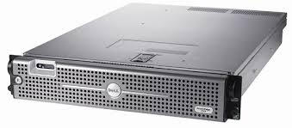
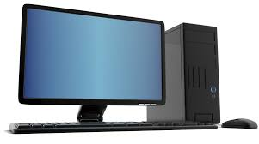
PERFORMANCE & SECURITY
Server Fizikal
Server Virtual
(Vmware, Hyper-V, Virtualbox,..)
Processor
Memory
Hard Disk
Network

Slide 27
PERFORMANCE & SECURITY
Operating System
Linux (Ubuntu, CentOS, ..)
BSD (FreeBSD, NetBSD, OpenBSD)
MS Window

Slide 28
PERFORMANCE & SECURITY
Web Server
Apache
NGINX
IIS
*Configuration

Slide 29
PERFORMANCE & SECURITY
Programming
PHP
Java
Javascript
Python
Ruby on Rails
*framework
*Configuration

Slide 30
PERFORMANCE & SECURITY
Database
MySQL, MariaDB
PostgreSQL
MSSQL
Oracle
*with Configuration

Slide 31
PERFORMANCE & SECURITY
Database
User authentication, authorization
Database
Table
Column type
Null, not null, default
Primary key
Foreign key
Indexing, unique,
Auto increment

Slide 32
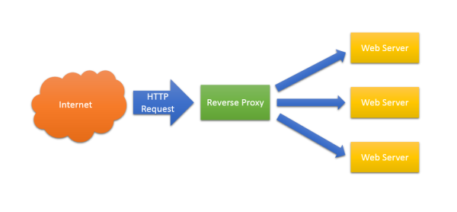
SECURITY & PERFORMANCE
REVERSE WEB PROXY
NGINX
APACHE
PORT 80, 443

Slide 33
PERFORMANCE & SECURITY
Network (LAN, DMZ, WAN, firewall, IPS, …)
High Availability (HA) – web server, DB Server
Backup – script, data

Slide 34
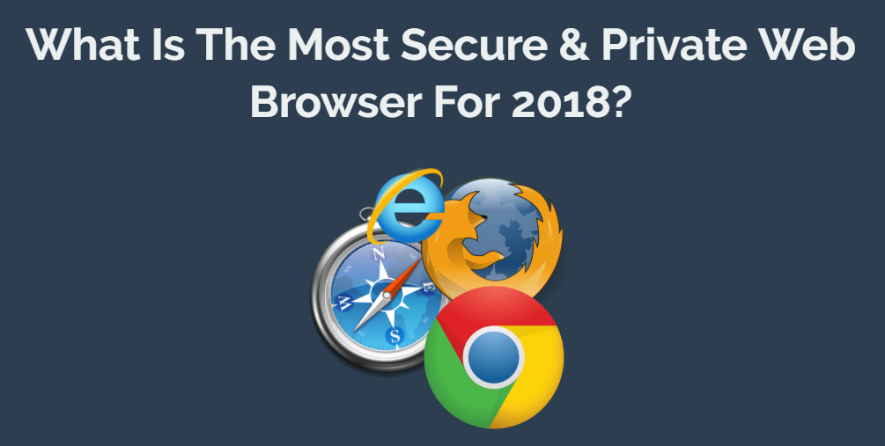
Web Browser
https://pixelprivacy.com/resources/secure-private-browser/

Slide 35


Browser Development tools (Chrome) or Firebug (Firefox)

Slide 36


Slide 37
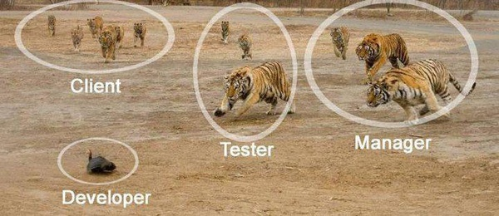
WEB APP DEVELOPMENT

Slide 38
WEB APP DEVELOPMENT
1. Impressive technical skills.
2. Willingness to learn.
3. Debugging skills.
4. Work environment match.
5. Problem-solving skills.
6. Passion for the work.
7. Grace under fire.

Slide 39
WEB APP DEVELOPMENT
8. People skills
9. Laziness
10. Patience
11. A business perspective.
12. Ability to plan.
13. Ability to handle failure.
15. Willingness to research.
16. Respect for deadlines.

Slide 40
Things You Should Know Before You Try Coding
1. Get the basics right
2. Build patience
3. Set a goal & move towards it
4. Do more projects
5. Get into social coding
6. Balance your learning
7. Learn algorithms
8. Take advantage of code documentation
9. Get used to tools
10. Get a mentor

Slide 41
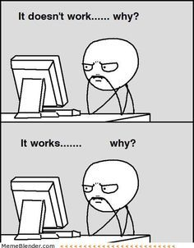
WEB APP DEVELOPMENT

Slide 42
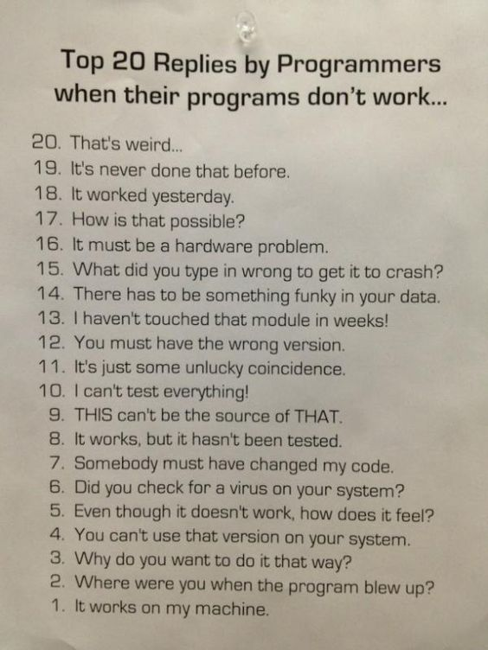

Slide 44


Slide 45
LEARN WEB PROGRAMMING
W3Schools
https://www.w3schools.com/
W3Schools is a popular web site for learning web technologies online.
tutorials and references : HTML, CSS, JavaScript, JSON, PHP, Python, AngularJS, SQL, Bootstrap, Node.js, jQuery, XQuery, AJAX, and XML.

Slide 46
SOFTWARE DEVELOPMENT
new techniques, languages and concepts pop up all of the time.
"can I keep up with the changes and stay competitive?"

Slide 47
PRINCIPLE OF SOFTWARE DEVELOPMENT
Don't Repeat Yourself (DRY)
good planning.

Slide 48
PRINCIPLE OF SOFTWARE DEVELOPMENT
Keep it simple, stupid (KISS)
systems work best if they are kept simple (rather than made complicated);
simplicity should be a key goal in design (complexity should be avoided)

Slide 49
PRINCIPLE OF SOFTWARE DEVELOPMENT
You aren't gonna need it (YAGNI)
programmer should not add functionality until deemed necessary
implement things when you actually need them

Slide 50
PRINCIPLE OF SOFTWARE DEVELOPMENT
App development
→ To reduce complexity
divide system (DIVIDE AND CONQUER)
→ components
→ subsystem / function

Slide 51
PRINCIPLE OF SOFTWARE DEVELOPMENT
SOLID
easy to maintain
extendable

Slide 52
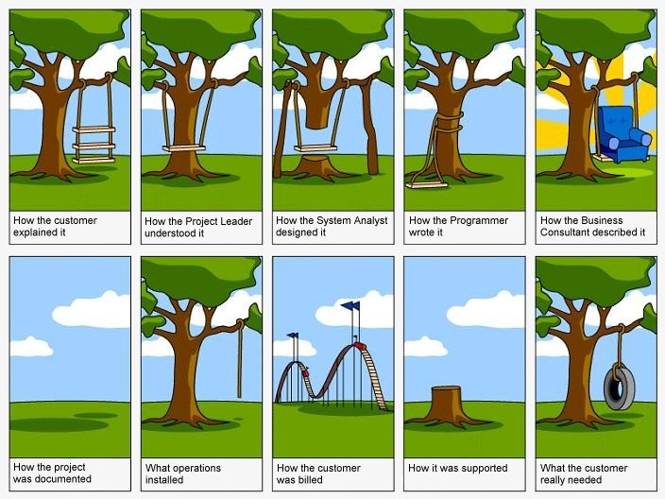
System Development vs Reality

Slide 53
APP DEVELOPMENT METHOTOLOGY
WATER FALL
RAPID DEVELOPMENT
SCRUM
EXTREME
KANBAN
AGILE

Slide 54
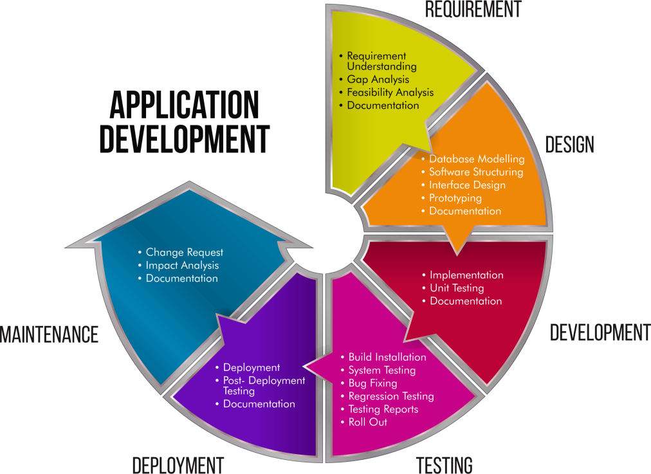

Slide 55
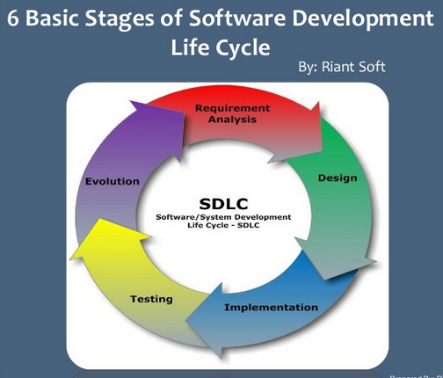

Slide 56

WEB APPLICATION DEVELOPMENT

Slide 57
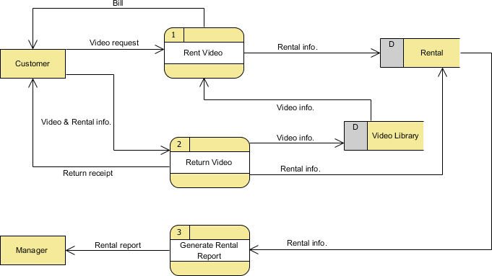
Data Flow Diagram

Slide 58
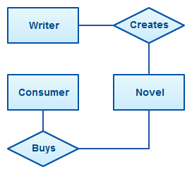
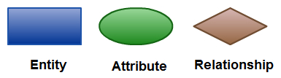
ERD /Entity Relationship Diagram / ER model

Slide 59
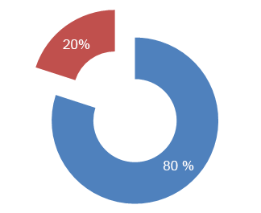
80% of the time spend on a software project is invested in 20% of the functionality.

Slide 60
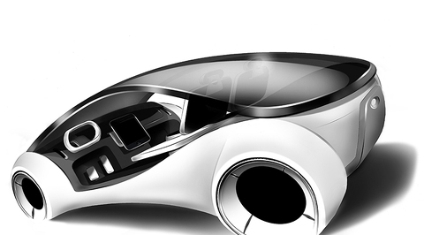
Prototype

Slide 61
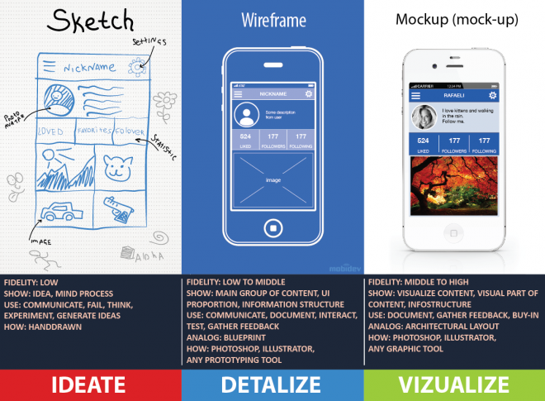
Prototype

Slide 62
Prototype
Don’t built it, fake it first
https://medium.com/@nhouse/dont-built-it-fake-it-first-guide-to-prototyping-7dbf288e75b6

Slide 63
Prototype
Showcase your idea
Save money & time
mockup/wireframe/prototype
Be sure about what exactly you would like to build
Gather feedback from customers

Slide 64
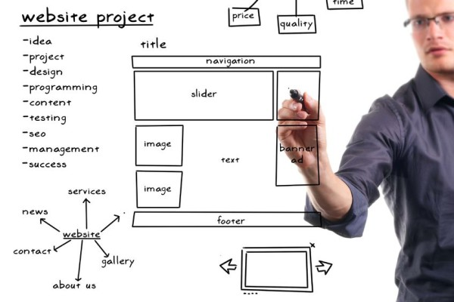
Wireframe / Mockup App / Web design process

Slide 65
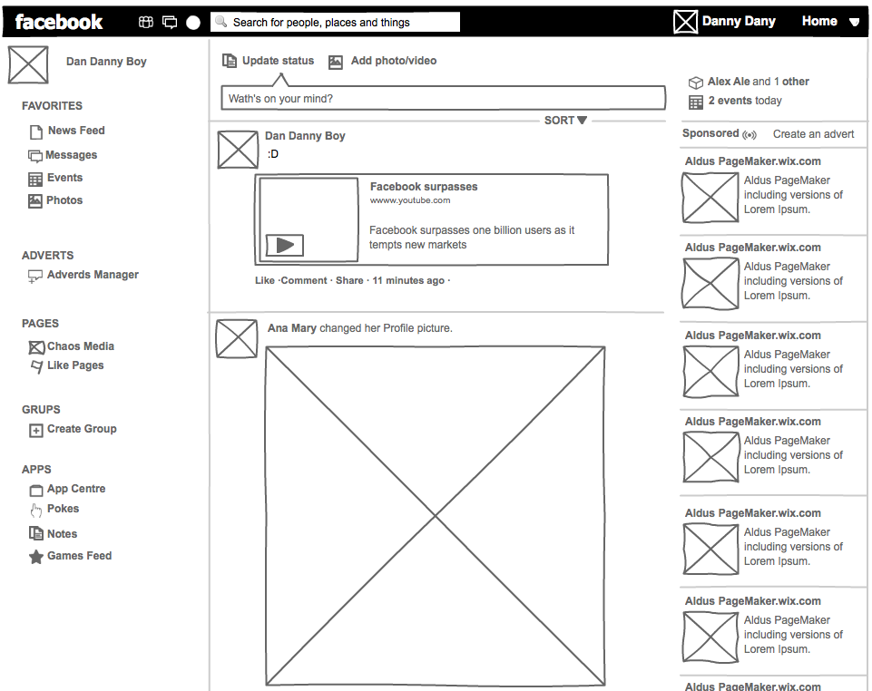
Wireframe / Mockup App / Web design process

Slide 66
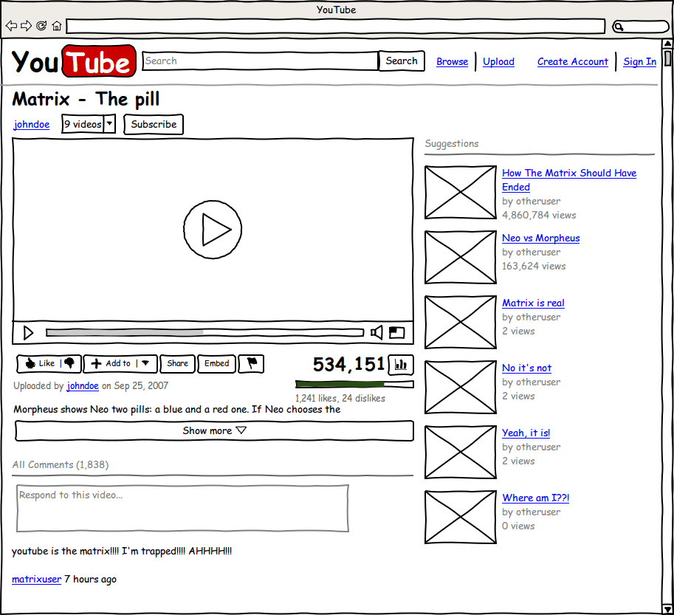
Wireframe / Mockup App / Web design process

Slide 67

Responsive Web Design (RWD)
MOBILE FRIENDLY

Slide 68
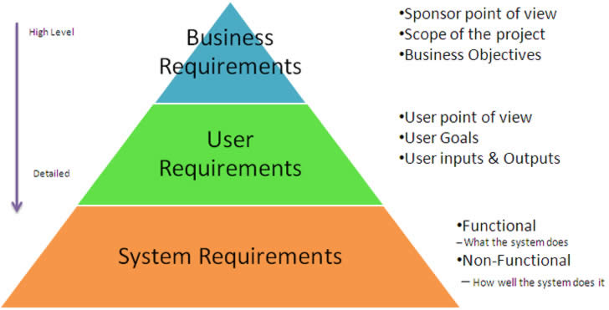

Slide 69
User Story
short, simple descriptions of a feature
told from the perspective of the person who desires the new capability,
user or customer of the system.
As a type of user (user/admin/guest/..) , I want some goal (what)
so that some reason (purpose / for what).

Slide 70
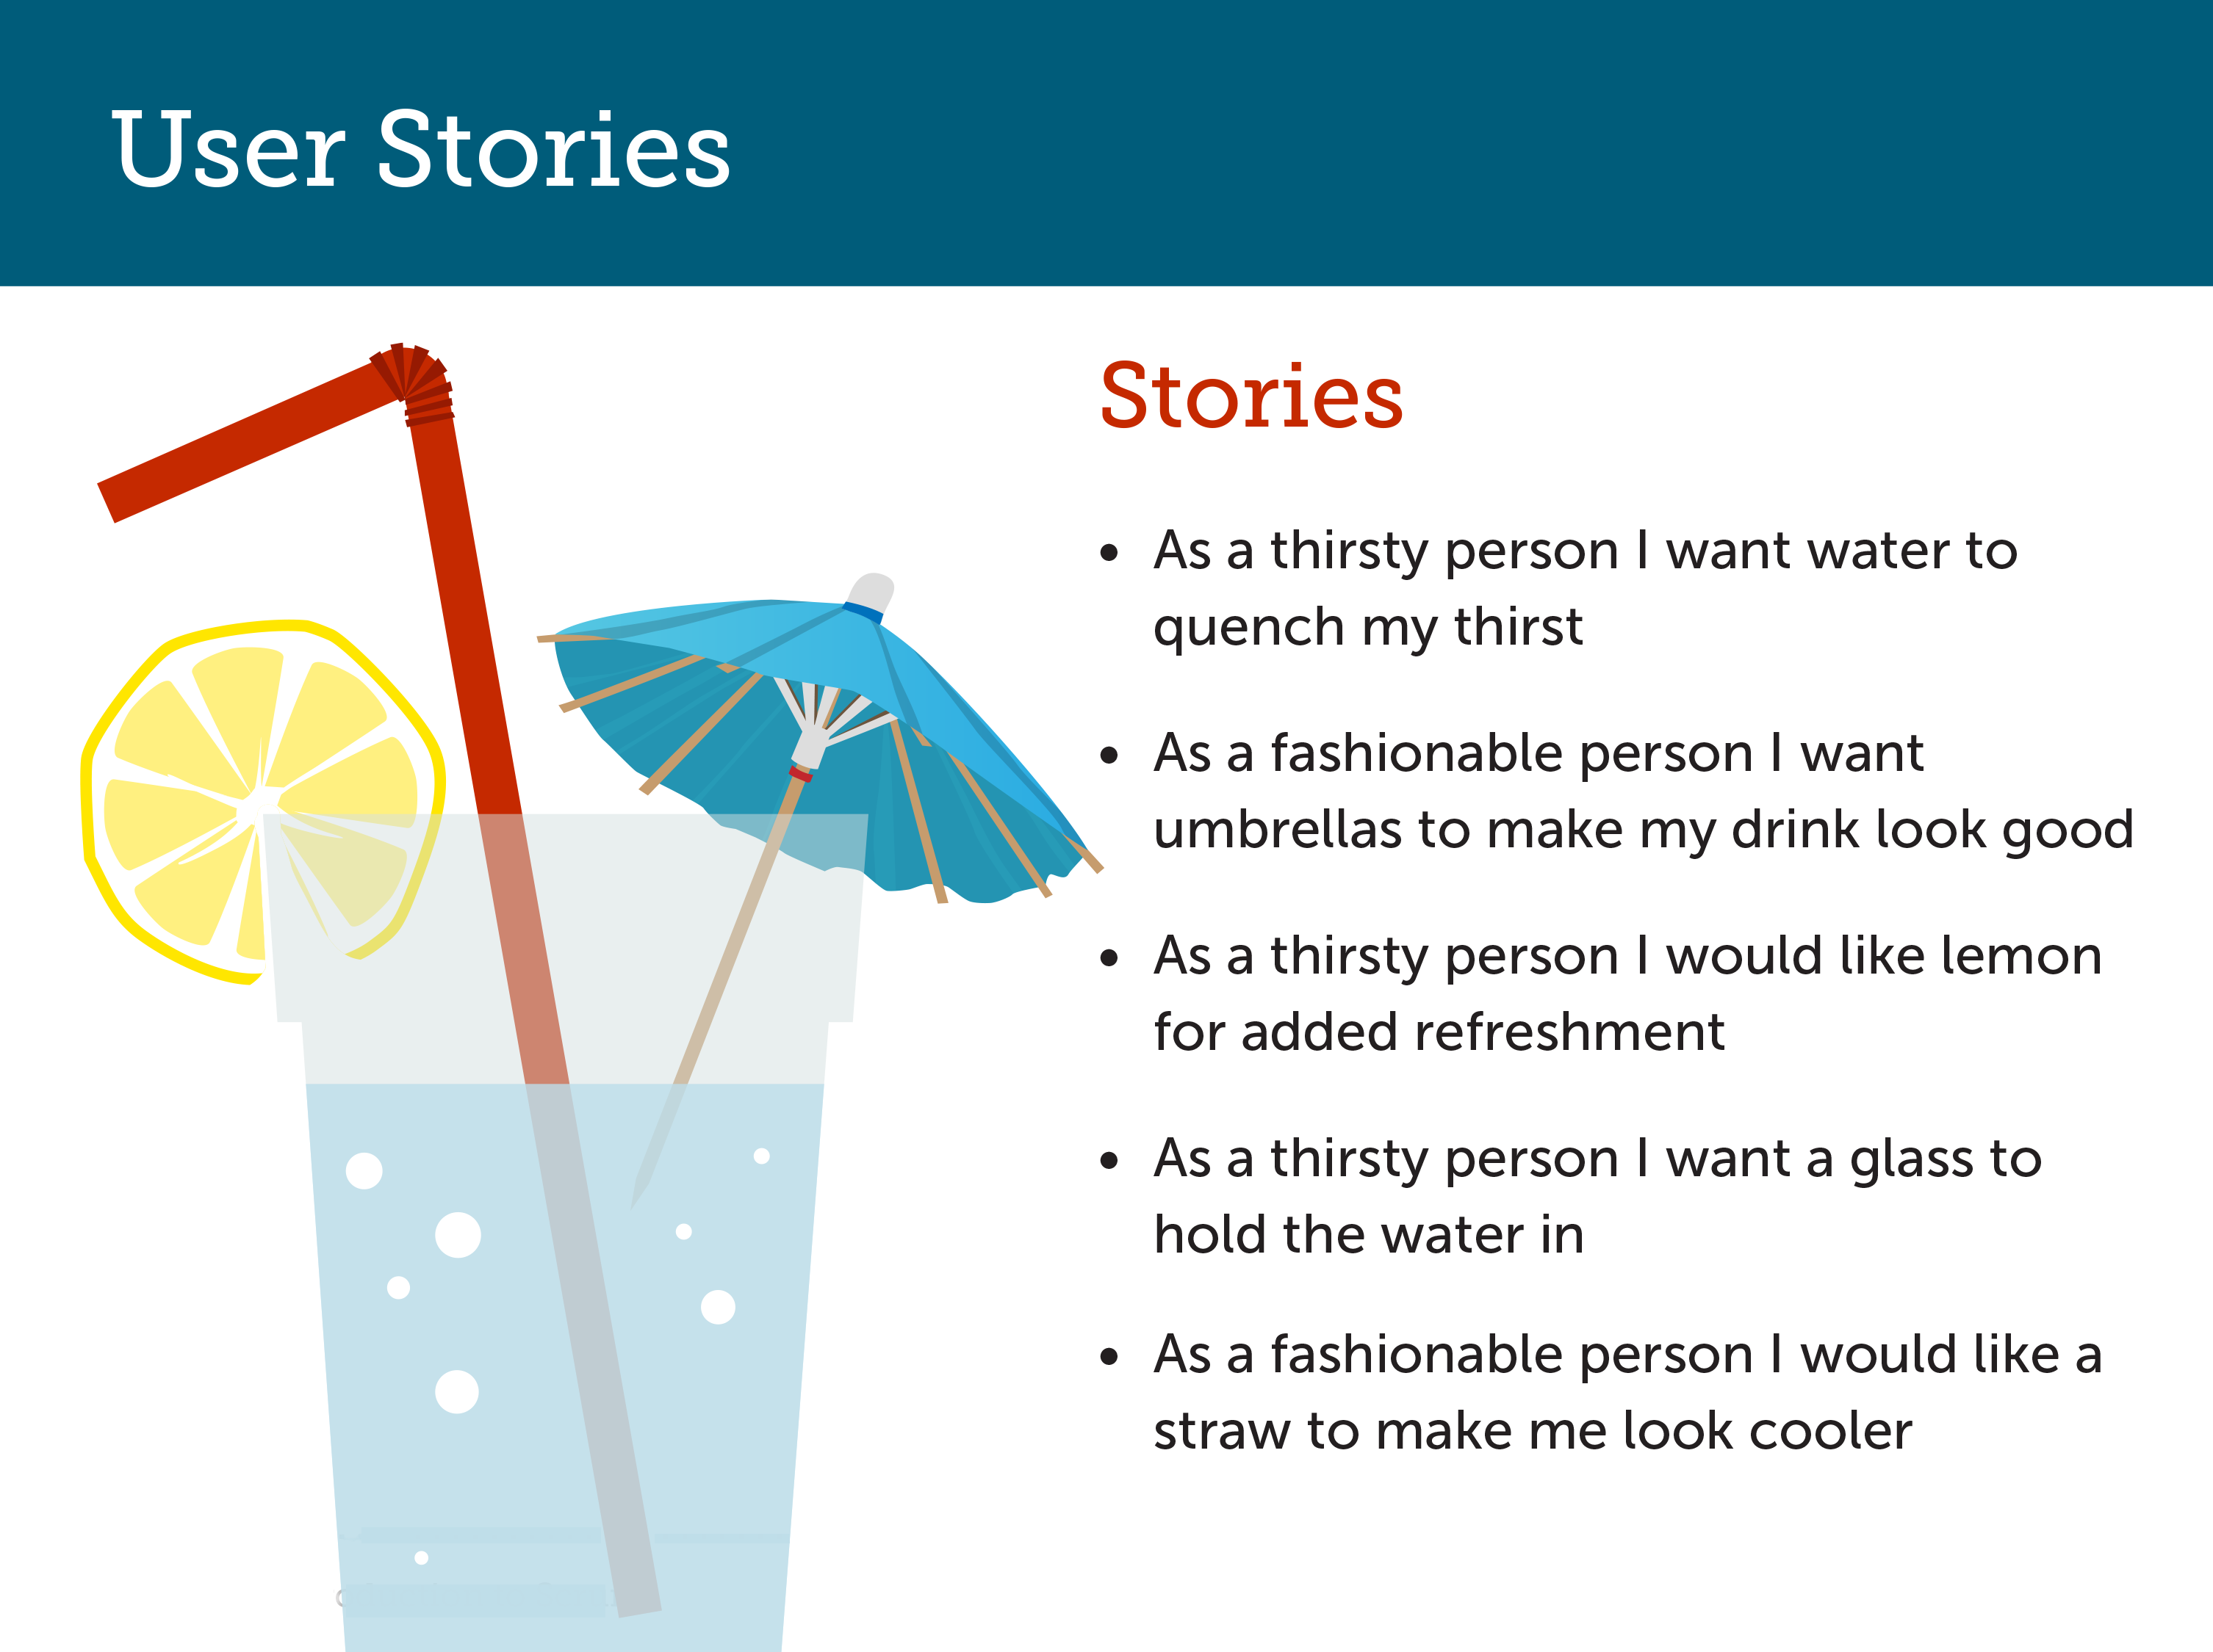

Slide 71
To Do List
No | Requirement / User Story | To Do Item / Task | Priority (H / M / L) | Start Date | End Date | Duration (day) | Status

Slide 72
PENGURUSAN PROJEK ICT SEKTOR AWAM
(PPISA)

